Slide 1
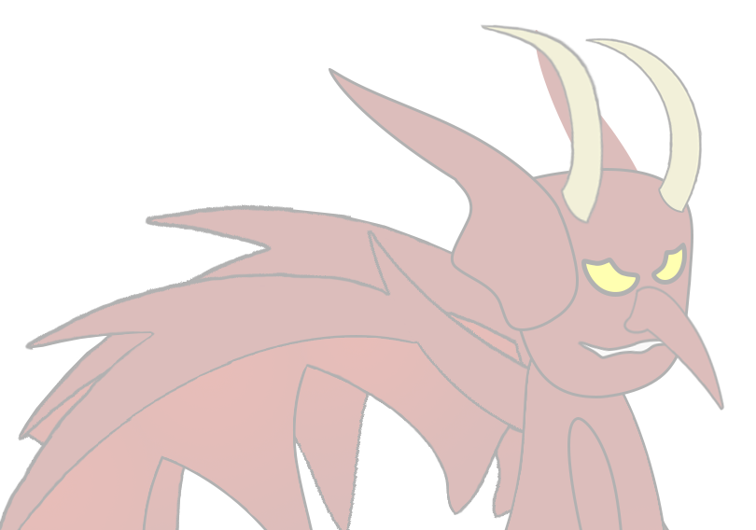
Level 4/5 Group 19
Ogheneochuko Ideh, Thomas Barrett & Samuel Ormondroyd

Slide 2
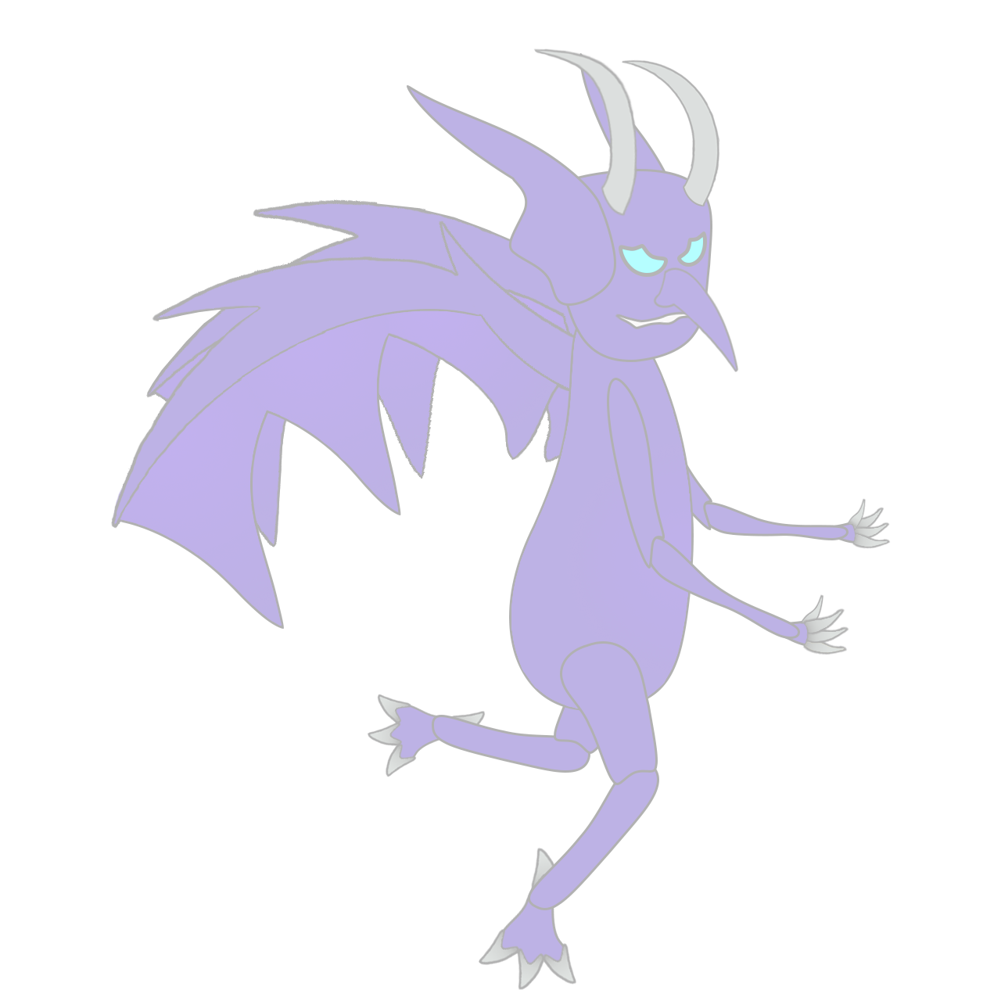
Sling It Wing It
Presented to:
Stakeholders & Ubisoft Bucharest

Slide 3
Business First
Group Members: | Emails:
Ogheneochuko Ideh:
Thomas Barrett:
Samuel Ormondroyd:
Group Members: | Hours Logged:
Ogheneochuko Ideh:
Thomas Barrett:
Samuel Ormondroyd:

Slide 4

Brief and recap
2 player adversarial physics game.
Logline
As God fling demons as far as physically possible whilst calling down your lighting to strike them even further.
USP
Erratic and funny wind mechanic.

Slide 5
Brief and recap
Projected Demographic | Unisex audience. Primarily target from ages 7-14. Appropriate for children (and adults) ages seven and up.
Genre: | The Triple A: Action, Arcade & Adversary.
Platform Specs: | Windows. Unity Executable.

Slide 6

Game
Players launch demons.
Demons momentum can be altered by erratic winds.
Players spawn lighting to propel demons further.
Demons may bounce of terrain propelling them in random directions.

Slide 7
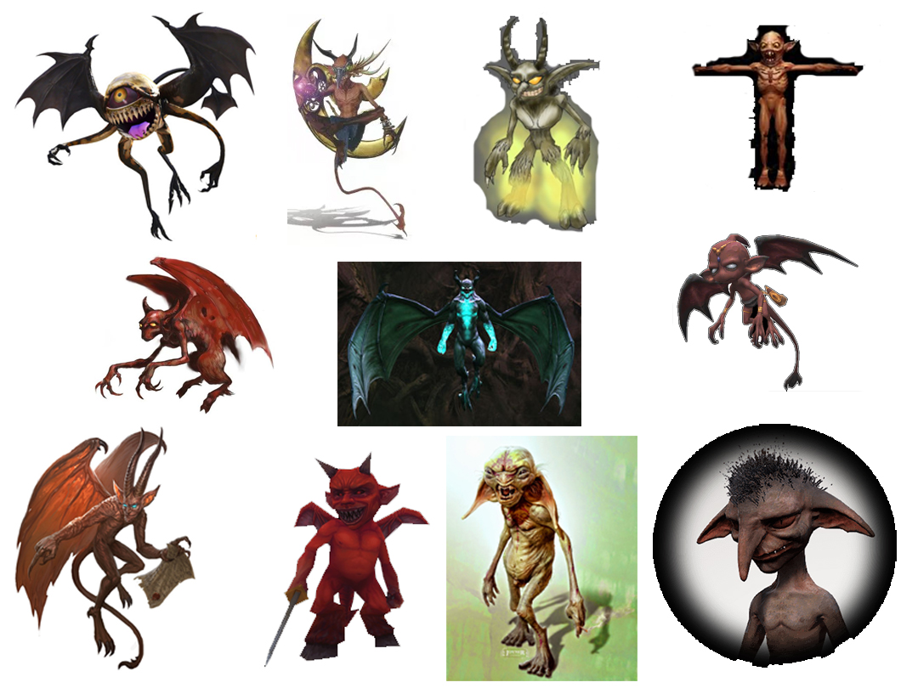
Mood boards

Slide 8
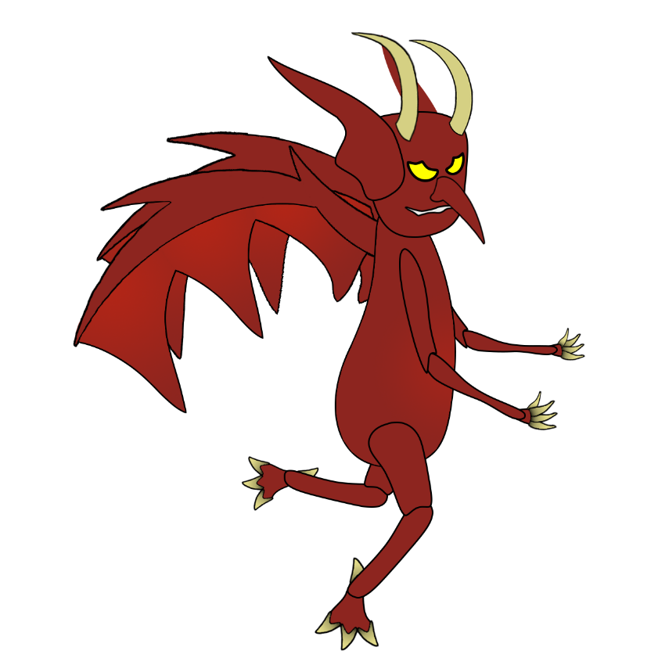
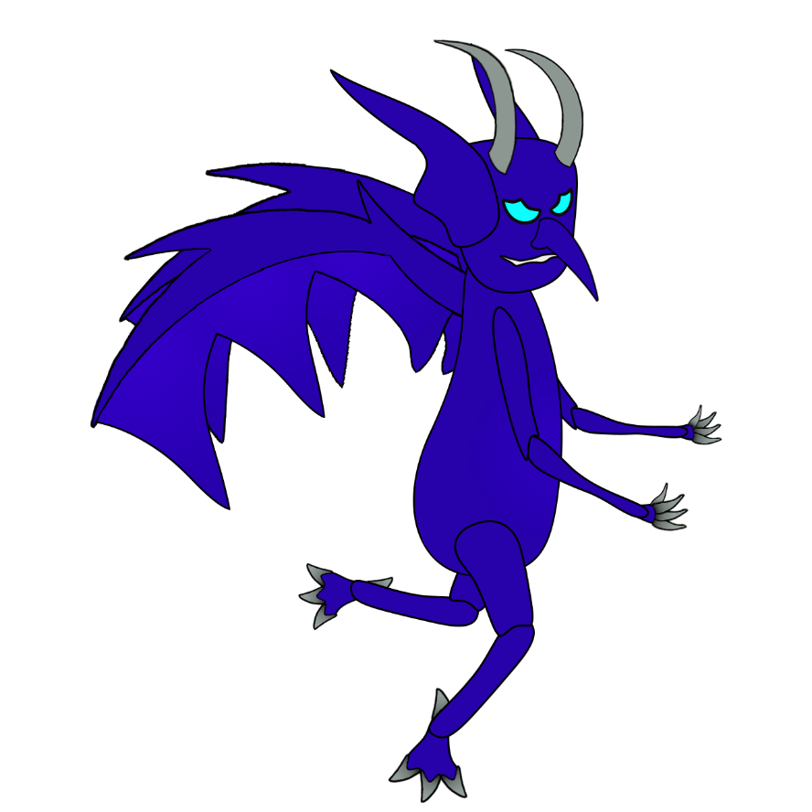


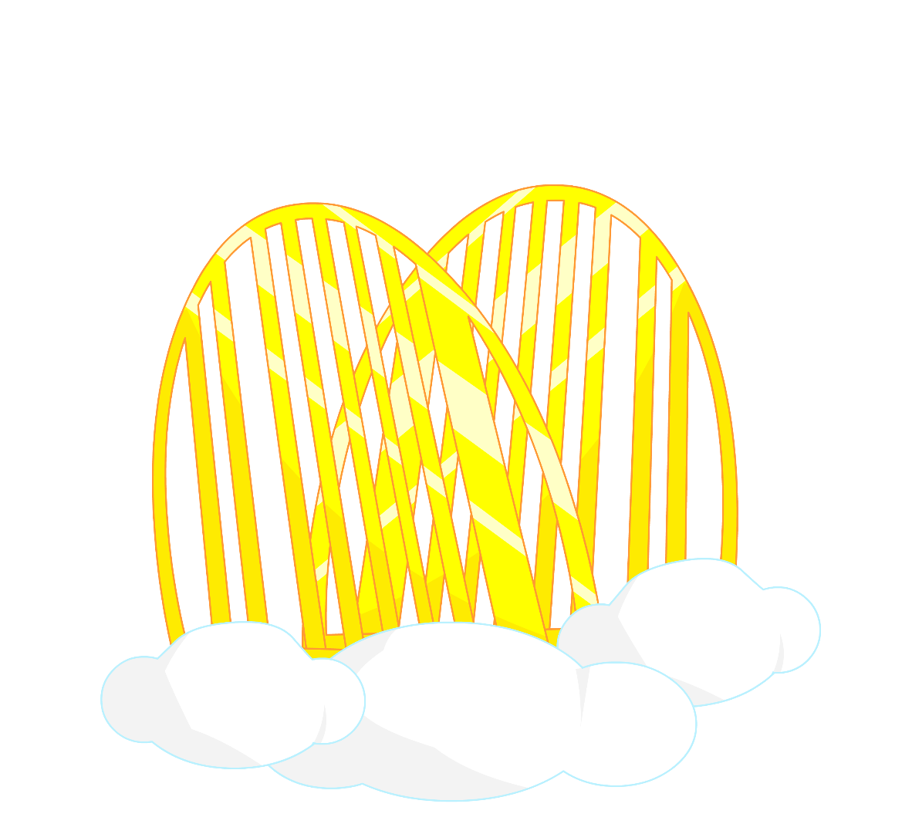


Art

Slide 9


Art

Slide 10
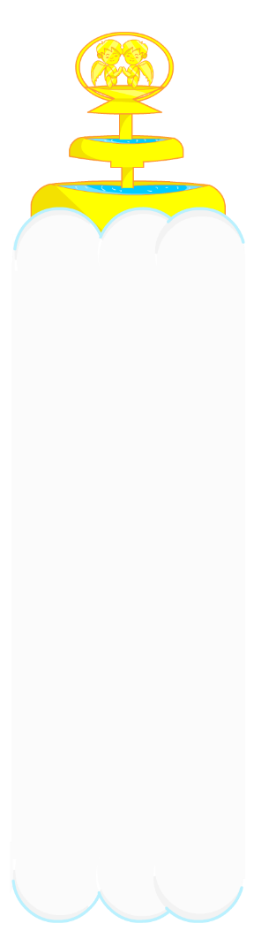

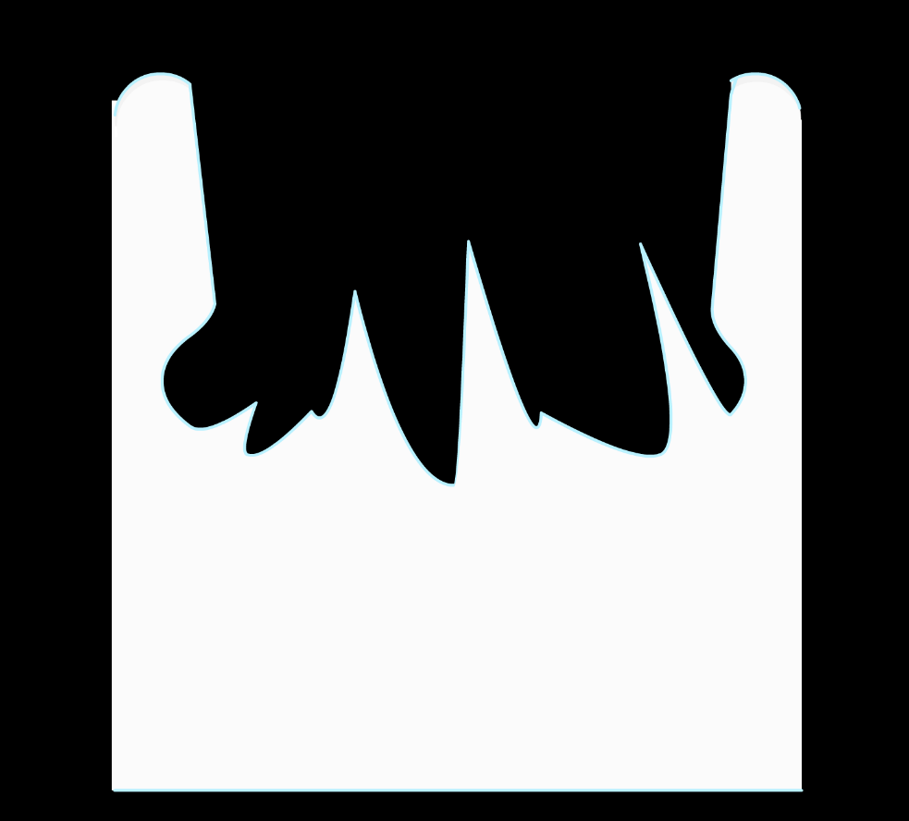

TilesET

Slide 11


TilesET

Slide 12

TilesET

Slide 13
Current Build

Slide 14
What will are projected to deliver.
Clear player affordances.
Cohesive two player gameplay.
Tweaked game variables based off playtesting.
Fully operating UI.
Title and main menu screens.
Implemented sounds.

Slide 15
How does game meets the brief?
The physics in our game is drawn from the momentum and trajectory applied to the demons at launch as well as the wind mechanic.
The physics continues through the demons recoiling off terrain.
Our gameplay is symmetric because the same affordance are given to players as well as having a symmetric playing field.
Our game is original because we had drawn from different

Slide 16
Questions?

